Slide 1
Project Group III
Sprint 4 – Final Product Presentation

Slide 2

Achieved Goals

Slide 3

Goals
Weather
User-friendly UI for main panel and rooms panel.
Communication
Statistics
Overview of the rooms
Individual controls
Automatic controls
Manual controls

Slide 4

Team-building & working

Slide 5

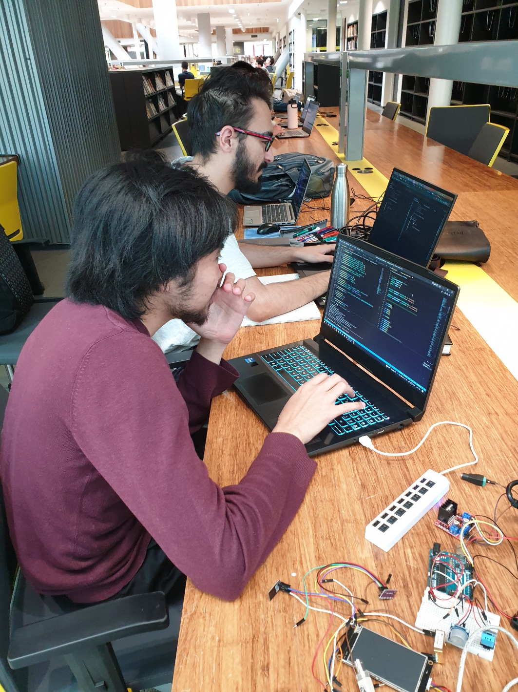
Being concentrated …

Slide 6

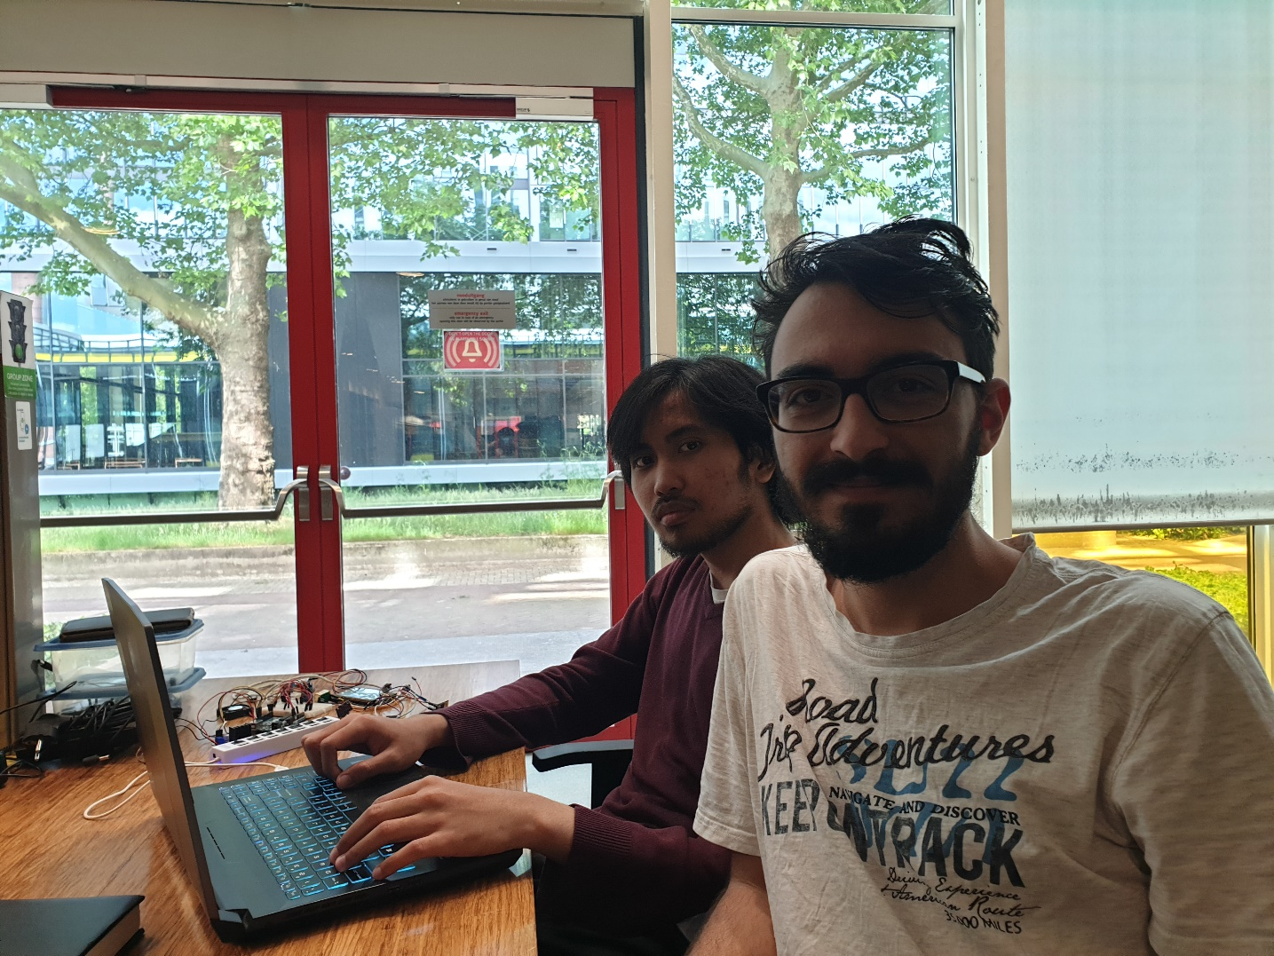
Teamwork ..

Slide 7
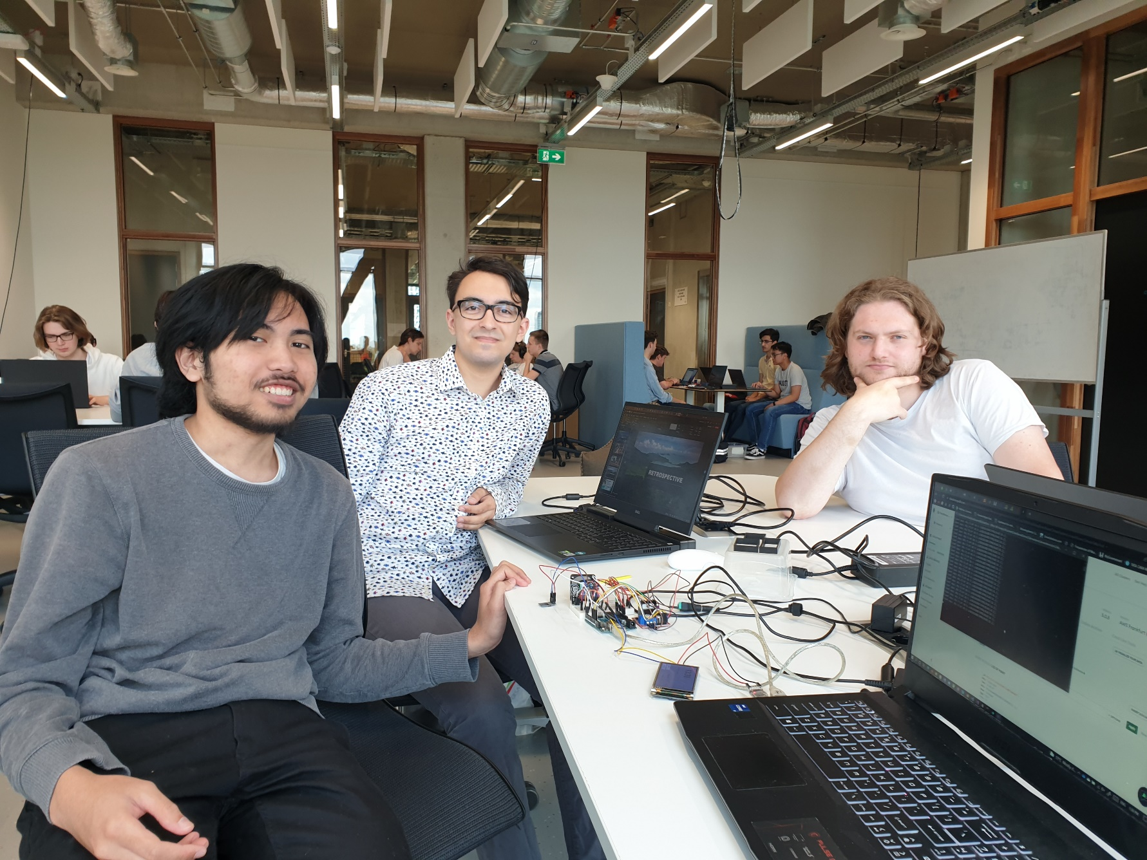
makes the dream work…

Slide 8
Retrospective

Slide 9

Things that went well:
Communication
Meetings outside school to work on the project
Fine tuning and repairs where they were made

